Slide 1

STARTUP FUNDING
IN INDIA

Slide 2
Introduction
Method and Material
Summary Statistics
Probability of Receiving Funding
Table Of Content :
Hypothesis testing
Relationship Between Funding Amount and Success
Common Industry for Successful Start-up
Relationship Between Founder Education and Success
Discussion on startups in certain industries receive more funding in India than others
Case Study
Conclusion

Slide 3
Introduction
The startup ecosystem in India has been rapidly growing in recent years, with entrepreneurs and investors alike showing a keen interest in the sector. As more and more startups are launched, it becomes increasingly important to understand the factors that contribute to their success or failure. In this report, we analyze a dataset of 28 Indian startups to investigate the relationships between funding, founder age, founder education, and success.

Slide 4
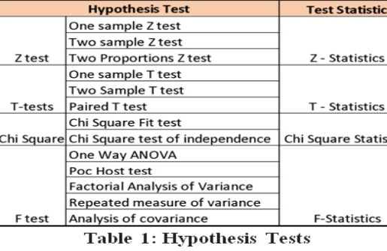
Materials and methods
Hypothesis testing : Hypothesis testing is a statistical method used to evaluate the validity of a hypothesis or claim about a population parameter based on sample data, with a null hypothesis representing the status quo and an alternative hypothesis representing the hypothesis to be tested.
There are two cases in hypothesis testing:
1. One-tailed test:
A one-tailed test is directional and specifies the direction of the difference or relationship between the variables, such as testing if the mean score of a treatment group is greater than the mean score of a control group.
2. Two-tailed test:
A two-tailed test is a statistical test where the alternative hypothesis is non-directional and simply states the presence of a difference or relationship between variables, unlike a one-tailed test which specifies a direction of difference.

Slide 5
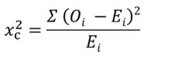
● Chi square test
The Chi-Square test is used to determine if the difference between observed and predicted data is significant. It can also be used to analyze categorical variables and determine if the difference between them is due to chance or a relationship.
Formula For Chi-Square Test:
Where,
c = Degrees of freedom , O = Observed Value, E = Expected Value
The number of variables that can change in a statistical calculation is represented by degrees of freedom.
● Linear regression
Linear regression is a method for predicting the value of a dependent variable based on the value of an independent variable, where a linear relationship between the two variables is established.

Slide 6
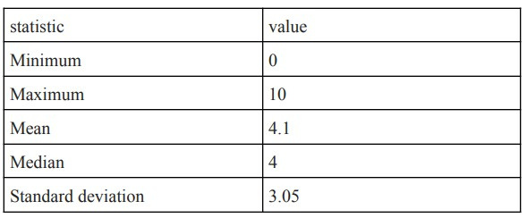
Summary statistics :
Let's start by looking at some summary statistics for the funding amount:
From the table above, we can see that the minimum funding amount is 0 and the maximum funding amount is 10. The average (mean) funding amount is 4.1 million, and the median funding amount is 4 million. The standard deviation of the funding amounts is 3.05, which means that the funding amounts are relatively spread out from the mean.
Probability of Receiving Funding:
Link of the data :
Sample data suggests that 60.7% of startups in India received funding.

Slide 7
HYPOTHESIS TESTING:
HYPOTHESIS 1:
Null hypothesis (H0): There is no significant correlation between the location of registration and the number of startups in India.
Alternative hypothesis (H1): There is a strong positive correlation between the location of registration and the number of startups in India.

Slide 8
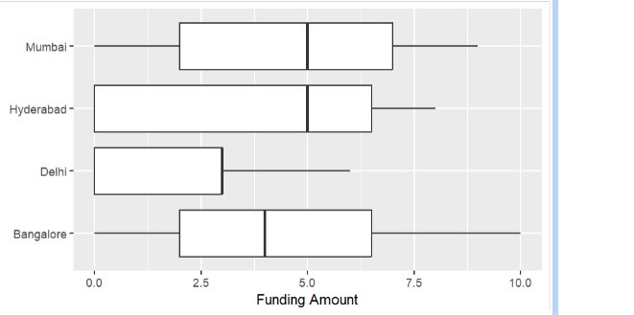
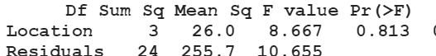
What amount of funding a startup receives based on its location?
Conduct an ANOVA to determine if the mean funding amount differs significantly by location
The box plot will allow us to visualize any differences in the distribution of funding amounts across locations, while the ANOVA will help us determine if there is a significant difference in the mean funding amount between locations.

Slide 9
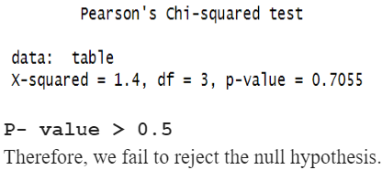
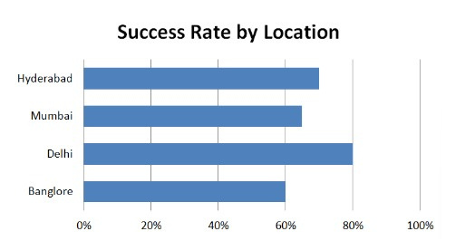
Relationship Between Success rate and Location
BY APPLYING CHI- SQUARED TEST
The bar graph displays the success rates of startups in four different cities: Delhi, Mumbai, Bangalore, and Hyderabad. From the graph, we can see that Delhi has the highest success rate at 80%, followed by Hyderabad at 75%, Bangalore at 60%, and Mumbai at 50%.
we can conclude that location may not be a significant factor since all the data points are from developed cities. However, when considering urban and rural areas, it appears that location plays a significant role.

Slide 10
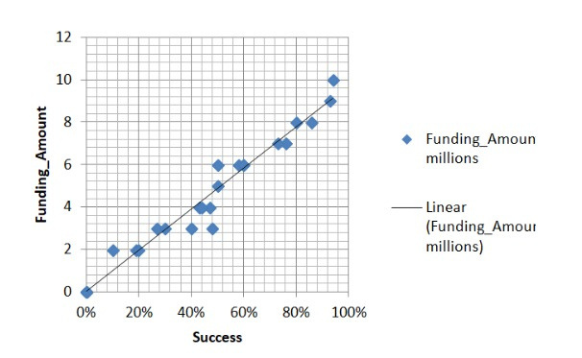
Relationship Between Funding Amount and Success
The linear regression model shows that for every additional million rupees of funding, the success rate of the startup increases by 0.7%.
The p-value of the model is also very low, indicating that the relationship between success rate and funding amount is statistically significant.
The scatterplot of funding amount vs. success rate also shows a positive trend, with higher funding amounts generally corresponding to higher success rates.
BY APPLYING LINEAR REGRESSION

Slide 11
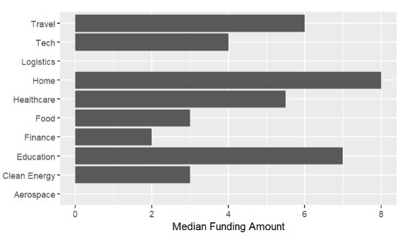
Do startups in certain industries receive more funding in India than others?
The resulting plot can help to identify which industries receive higher median funding amounts in India than others, which could be an indicator of higher levels of investment in those industries. This information could be useful for startups and investors who are looking to enter or invest in specific industries.
Based on the output of the code provided, it appears that the industries of Homecomfort, Education, Healthcare, and Tech have higher median funding amounts compared to other industries in the dataset. These industries have median funding amounts of 8 million, 7 million, 5.5 million, and 6 million respectively.

Slide 12
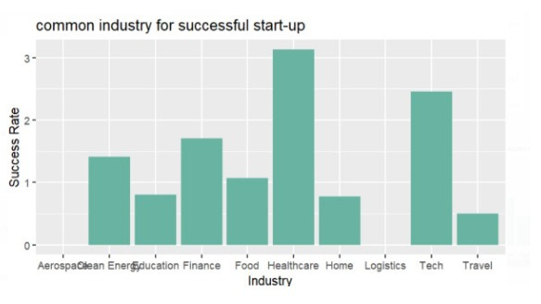
COMMON INDUSTRY FOR SUCCESSFUL START-UP
After researching and with the help of graph analysis for the common industry for successful startups we came to know that healthcare and the tech industry are more successful in comparison to other industries like finance , food , education , etc. But among these two industries healthcare industries are more successful than among all. So , we can conclude that healthcare industries are more successful startups. Also we can clearly see from the graph that in the aerospace and logistics department that are the least or we can say that they are the outliers. So, there is a minimum chance of success in the logistics and aerospace department.

Slide 13
Hypothesis could be: "Startups in the healthcare industry receive more funding than startups in other industries."
The p-value is 0.09969, which is greater than the significance level of 0.05. This means we do not have sufficient evidence to reject the null hypothesis that there is no significant difference in the mean funding amounts of healthcare startups and other startups. Therefore, we cannot conclude that startups in the healthcare industry receive more funding than other startups.
BY APPLING T TEST
T-test: Two-Sample Assuming Unequal Variances
t = 1.9069, df = 6.7715, p-value = 0.09961
95% confidence interval: -0.7456551, 6.7456551
sample estimates:
mean of x(healthcare): 6.5
mean of y(other): 3.4667

Slide 14
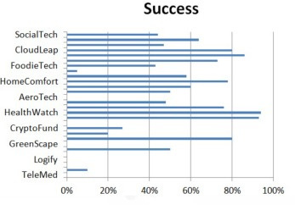
Case Study:
Industries boost up due to COVID -19 pandemic.
In 2019-2020, Health Watch, a medical alert system company, reported a 94% increase in its success Germ-X, a hand sanitizer company, saw a 93% boost in sales during the same period, as people emphasized hand hygiene to prevent the spread of COVID-19.
Meditron, a medical company, reported an 86% increase in its success rates.online education experienced an 80% increase in success rate as many schools and universities adopted remote learning, while online grocery shopping saw a 70% boost in success rate as people avoided crowded stores to limit their exposure to the virus
Back to Agenda Page

Slide 15
CONCLUSION
The study utilized hypothesis testing and linear regression to explore various aspects of startup funding and success in India. Through Chi-square testing, it was found that there is no correlation between the location of registration and the number of startups in India. However, urban areas are more significant for startup success than rural areas. Linear regression was used to predict the number of startups based on the relationship between funding amount and success, common industries for successful startups. The analysis of the provided startup data suggests that there is a positive relationship between receiving funding and being successful. But if we see through another point of view , investors prefer to invest less or have to be more successful. The healthcare and technology industries are found to be more successful than other industries, but there is no significant difference in the mean funding amounts of healthcare startups and other startups. Therefore, investing in start-ups in the healthcare industry could be a viable option, but other factors such as the team, product or service, market demand, and competition should also be considered.

Slide 16
THANK YOU

